Slide 1

COMPUTER ARCHITECTURE AND ASSEMBLY
BY Mr. Majyambere Alain Christian
Telephone: 0788767895
Email: alchris0724@gmail.com

Slide 2
CHAP I.
INTRODUCTION TO COMPUTER SYSTEMS
1.1 INTRODUCTION:
As technology advances in computer industry, there is a need to understand the factors affecting computing today and to forecast the
future of computation.
A great majority of the computers of our daily use are designed for "general purpose machines" because they are built with no specific application in mind, or are designed for "special purpose machines" to serve specific applications.

Slide 3
Introduction Cont-
But what do we mean by a computer?
Different types: desktop, servers, embedded devices, accessories,etc…
Different uses: automobiles, graphics, finance, …
Different manufacturers: Intel, Apple, IBM, Microsoft, Sun…
Different underlying technologies and different costs!

Slide 4
What is a computer?
Components:
  input (mouse, keyboard)
  output (display, printer)
  memory (disk drives, DRAM, SRAM, CD)
  network
Our primary focus:
the processor (data path and control)
  implemented using millions of transistors
  Impossible to understand by looking at each transistor
  Computer Types
  Computer Software /Hardware Types.
  Therefore, what is common in all this computers?

Slide 5
Overview of the Computer Architecture
    Computer is a digital device, which works on two levels of signal which are High and Low.
    The High-level signal basically corresponds to some high-level signal (say 5 Volt or 12 Volt) and Low-level signal basically corresponds to Low-level signal (say 0 Volt).
    Computer technology has made incredible improvement in the past half century. In the early part of computer evolution, there were no stored-program computer, the computational power was less and on the top of it, the size of the computer was a very huge one.

Slide 6
  Today, a personal computer has more computational power, more main memory, more disk storage, smaller in size and it is available in affordable cost.
    Main Parts of a Computer (HW)
    Central Processing Unit
    Motherboard
    Memory (RAM)
    I/O Units
    Bus

Slide 7
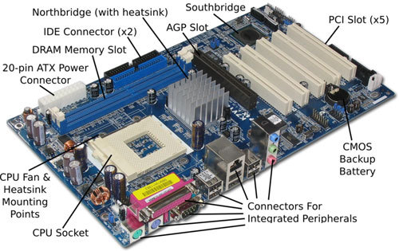
Basic parts of a motherboard:

Slide 8
1.2. HISTORICAL BACKGROUND
History of computer Architecture is divided into 4 major generations.
Each generation is characterized by a major technological development which includes these fundamental changes are in terms of:
      - Size (from room to desk)
      - Cost (from large organizations to individuals)
      - Power (Power efficiency can often be traded for performance or cost benefits)
      - Efficiency (in terms of performance what they can do)
      - Reliability

Slide 9
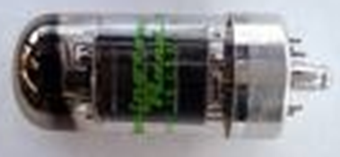
First Generation (1940-1950) – Vacuum Tube
Vacuum Tube (basic device): In electronics, a vacuum tube is a device used to amplify, switch, otherwise modify, or create an electrical signal by controlling the movement of electrons in a low-pressure space.
1. ENIAC (Electronic Numerical Integrator And Computer) - 1945: Designed by Mauchly & Echert, built by US army to calculate trajectories for ballistic shells during WWII, used 18,000 vacuum tubes and 1,500 relays, programmed by manually setting switches.

Slide 10
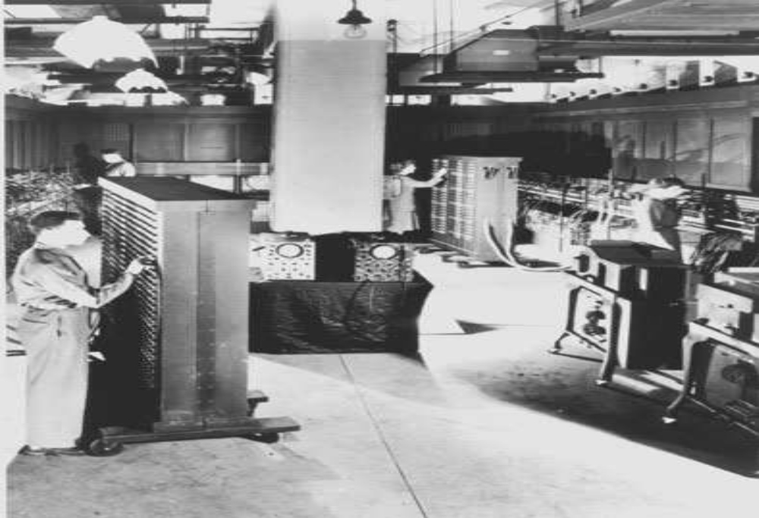
ENIAC

Slide 11
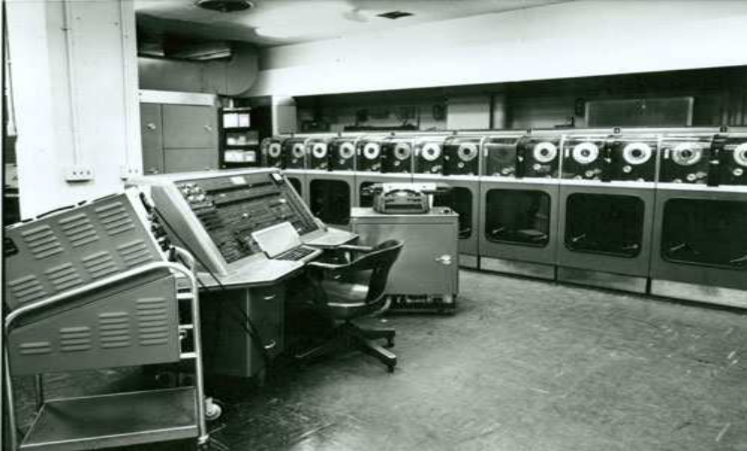
UNIVAC (UNIVersal Automatic Computer) – 1950: the first commercial computer. Faster than ENIAC, used binary code instead of base-ten.

Slide 12
John Von Neumann architecture: Goldstine and Von Neumann took the idea of ENIAC and developed concept of storing a program in the memory. Known as the “Von Neumann” architecture and has been virtually the basis for every machine designed since then.
As far as general-purpose machines are concerned, the University of Pennsylvania is recorded to have hosted the building of the Electronic Numerical Integrator and Calculator (ENIAC) machine in 1944. It was the first operational general-purpose machine built using vacuum tubes (built to help compute artillery firing tables during World War II).
IBM announced its first computer, the IBM701, in 1952 after progress projects initiated at Cambridge and Harvard Universities.

Slide 13
FIRST GENERATION FEATURES
- Electron emitting devices
- Data and programs are stored in a single read-write memory
- Memory contents are addressable by location, regardless of the content itself
- Machine language/Assembly language
- Sequential execution
FIRST GENERATION DISADVANTAGES
- Expensive,
- Bulky (Using very many lights)
- Unreliable,
- Power consummation
- Used punched cards/tapes, magnetic drum memories, machine language

Slide 14
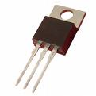
SECOND GENERATION (1950-1964) – TRANSISTORS
  Transistor: In electronics, a transistor is a semiconductor device commonly used to amplify or switch electronic signals.
  A transistor is made of a solid piece of a semiconductor material, with at least three terminals for connection to an external circuit. A voltage or current applied to one pair of the transistor's terminals changes the current flowing through another pair of terminals.

Slide 15
  William Shockley, John Bardeen, and Walter Brattain invent the transistor that reduce size of computers and improve reliability.
  First operating Systems: handled one program at a time
  On-off switches controlled by electricity
  High level languages
  Floating point arithmetic
  SECOND GENERATION FEATURES:
  Smaller, Faster, Cheaper, More energy efficient and more reliable as compared to vacuum tubes, Assembly languages, early versions of FORTRAN and COBOL

Slide 16
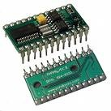
THIRD GENERATION (1964-1974) – INTEGRATED CIRCUITS (IC)
- Microprocessor chips combines thousands of transistors, entire circuit on one computer Chip
- Semiconductor memory
- Multiple computer models with different performance characteristics
- Smaller computers that did not need a specialized room

Slide 17
THIRD GENERATION FEATURES
- Small Scale Integration (few tens of transistors), Medium Scale Integration(few hundreds of transistors), Large Scale Integration (few thousands of transistors)
- Speed and efficiency drastically increased
- Keyboard and monitors appeared
- Operating systems

Slide 18
Fourth Generation (1974-present) – Very Large-Scale Integration (VLSI)/Ultra Large Scale Integration (ULSI)
Combines millions of transistors
Single-chip processor and the single-board computer emerged
Creation of the Personal Computer (PC)
Graphics and mouse \ hand held devices
Wide spread use of data communications
Artificial intelligence: Functions & logic predicates
Object-Oriented programming: Objects & operations on objects
Massively parallel machine

Slide 19
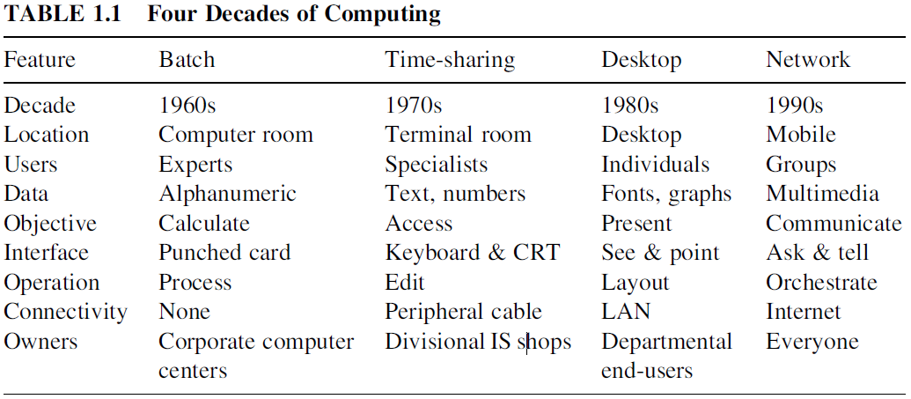

Slide 20
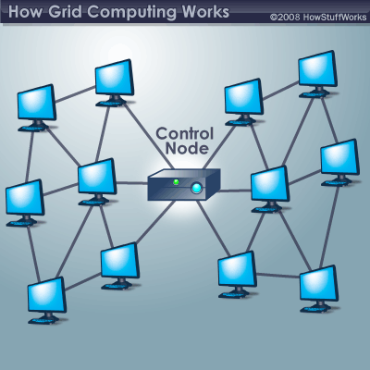
LOOKING INTO FUTURE
Grid computing: Grid computing is a computer network in which each computer's resources are shared with every other computer in the system. Many computers spread across the world trying to solve a single problem. Grids are geographically distributed platforms of computation. They should provide dependable, consistent, pervasive, and inexpensive access to high-end computational facilities.

Slide 21
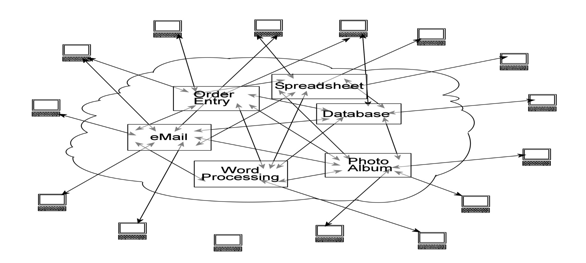
Cloud Computing: Instead of installing a suite of software for each computer, you'd only have to load one application. That application would allow workers to log into a Web-based service which hosts all the programs the user would need for his or her job. Remote machines owned by another company would run everything from e-mail to word processing to complex data analysis programs.

Slide 22
1.3. ARCHITECTURAL DEVELOPMENT AND STYLES
Computer architects have always been striving to increase the performance of their architectures.
There is a philosophy that by doing more in a single instruction, one can use a smaller number of instructions to perform the same job.
The immediate consequence of this is the need for fewer memory read/write operations and an eventual speedup of operations.
It was also argued that increasing the complexity of instructions and the number of addressing modes has the theoretical advantage of reducing the “semantic gap” between the instructions in a high-level language and those in the low-level (machine) language.

Slide 23
A single (machine) instruction to convert several binary coded decimal (BCD) numbers to binary is an example for how complex some instructions were intended to be.
Machines following this philosophy have been referred to as complex instructions set computers
(CISCs). Examples of CISC machines include the Intel Pentium, the Motorola, IBM & Macintosh .
Another philosophy promotes the optimization of
architectures by speeding up those operations that are most frequently used while reducing the instruction complexities and the number of addressing modes known as reduced instructions set computers (RISCs).
The majority of contemporary microprocessor chips seems to follow the RISC paradigm.

Slide 24
CISC and RISC
CISC | RISC
- Emphasis on hardware - Instructions take a varying amount of cycle time | - Emphasis on software - Instruction take one cycle time
- Multiple instruction sizes and formats | - Instructions of the same set
- Less registers | - Use more registers
- Pipelining is difficult | - Pipelining is easy

Slide 25
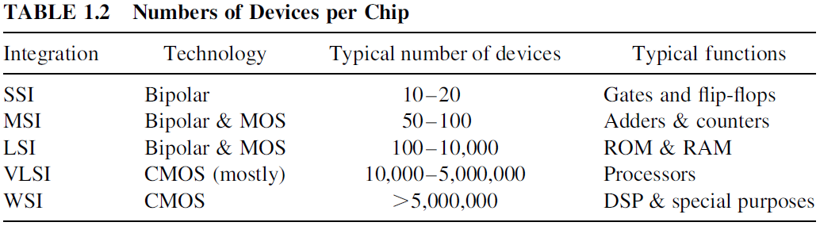
1.4. TECHNOLOGICAL DEVELOPMENT
Computer technology has shown an unprecedented rate of improvement. This includes the development of processors and memories.
This impressive increase has been made possible by the advances in the fabrication technology of transistors. The scale of integration has grown from small-scale (SSI) to medium-scale (MSI) to large-scale (LSI) to very large-scale integration (VLSI), and currently to waferscale integration (WSI).

Slide 26
It should be mentioned that the continuous decrease in the minimum devices feature size (eg tablets) has led to a continuous increase in the number of devices per chip, which in turn has led to a number of developments.
Among these are the increase in the number of devices in RAM memories, which in turn helps designers to trade off memory size for speed.
The improvement in the feature size provides golden opportunities for introducing improved design styles.

Slide 27
1.5. PERFORMANCE MEASURES
we consider the important issue of assessing the performance of a computer.
For example, a user of a computer measures its performance based on the time taken to execute a given job (program). On the other hand, a laboratory engineer measures the performance of his system by the total amount of work done in a given time.
Performance analysis should help answering questions such as how fast can a program be executed using a given computer?
In order to answer such a question, we need to determine the time taken by a computer to execute a given job.

Slide 28
The Clock cycles allow counting unit computations,
because the storage of computation results is synchronized with rising (trailing) clock edges.
The time required to execute a job by a computer is often expressed in terms of clock cycles.
We denote the number of CPU clock cycles for executing a job to be the cycle count (CC), the cycle time by CT, the clock frequency by f = 1/CT. The time taken by the CPU to execute a job can be expressed as CPU time = CC * CT = CC/f
Therefore, the average number of clock cycles per instruction (CPI) has been used as an alternate performance measure. The following equation shows how to compute the CPI.

Slide 29
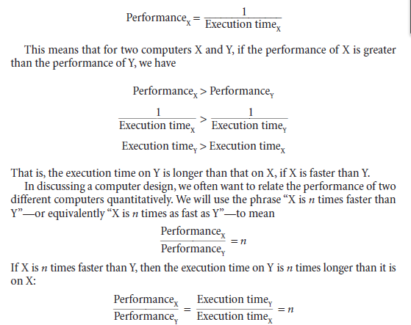

Slide 30
Example:
Time taken to run a program = 10s on A, 15s on B
Relative performance =Execution TimeB / Execution Time A =15s/10s =1.5 Therefore, A is 1.5 times faster than B
Measuring Execution Time
Elapsed time
- Total response time, including all aspects Processing, I/O, OS overhead, idle time
- Determines system performance
CPU time
- Time spent processing a given job Discounts I/O time, other jobs’ shares
- Comprises user CPU time and system CPU time
- Different programs are affected differently by CPU and system performance

Slide 31
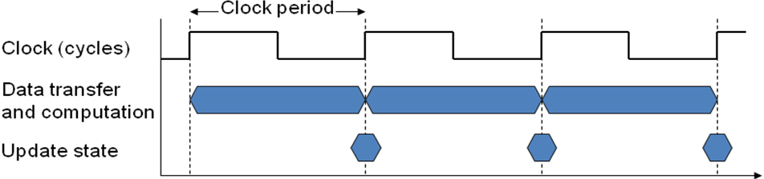
CPU Clocking
Operation of digital hardware governed by a constant-rate clock. Clock period: duration of a clock cycle, e.g: 0.25ns and Clock frequency (rate): cycles per second, e.g: 4.0GHz

Slide 32
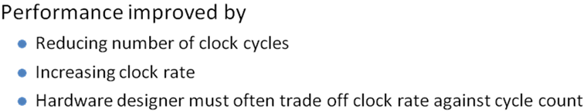
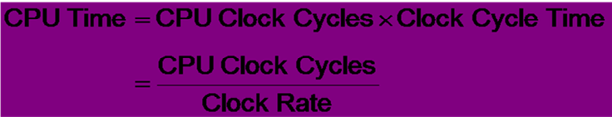
CPU TIME

Slide 33
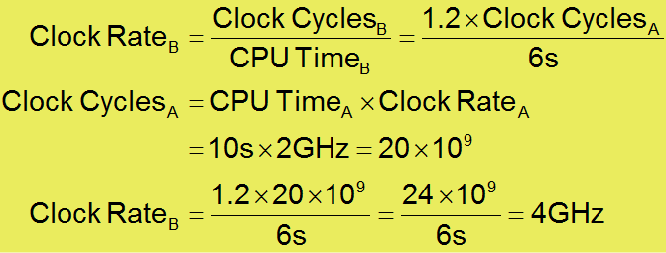
Example
Computer A: 2GHz clock, 10s CPU time
Designing Computer B with Aim for 6s CPU time, can do faster clock, but causes 1.2 × clock cycles.
How fast must Computer B clock be?

Slide 34
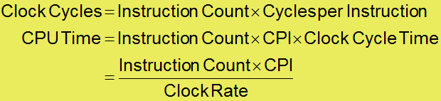
Instruction Count and CPI
- Instruction Count for a program is determined by program, ISA and compiler
- Average cycles per instruction is determined by CPU hardware and If different instructions have different CPI
    Average CPI affected by instruction mix

Slide 35
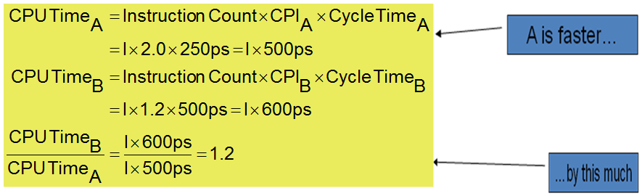
CPI Example
Computer A: Cycle Time = 250ps, CPI = 2.0
Computer B: Cycle Time = 500ps, CPI = 1.2
Both computer use same ISA, Which is faster, and by how much?

Slide 36
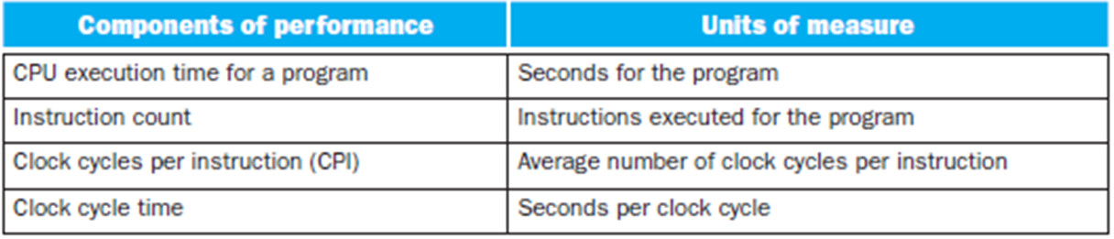
Therefore:

